Slide 1
Improving Consumer Understanding of Medicare Advantage
Better Medicare Alliance Capitol Hill Briefing
April 20, 2018

Slide 2
National Association of Area Agencies on Aging (n4a)
WHO WE ARE
501(c)(3) membership association representing America’s national network of 622 Area Agencies on Aging (AAAs) and providing a voice in the nation’s capital for more than 250 Title VI Native American aging programs.
OUR MISSION
To build the capacity of our members so they can help older adults and people with disabilities live with dignity and choices in their homes and communities for as long as possible.

Slide 3
State Health Insurance Assistance Program (SHIP)
SHIP was created under Section 4360 of the Omnibus Budget Reconciliation Act (OBRA) of 1990 (Public Law 101-508). This section of the law authorized the Centers for Medicare & Medicaid Services (CMS) to make grants to states to establish and maintain health insurance advisory service programs for Medicare beneficiaries.
Grant funds were made available to support information, counseling, and assistance activities relating to Medicare, Medicaid, and other related health insurance options such as: Medicare supplement insurance, long-term care insurance, and managed care options.
Authorized in the Consolidated Appropriations Act of 2014, SHIP was transferred from CMS to the Administration for Community Living (ACL) in 2014. This transfer reflects the existing formal and informal collaborations between the SHIP programs and the networks that ACL serves.

Slide 4
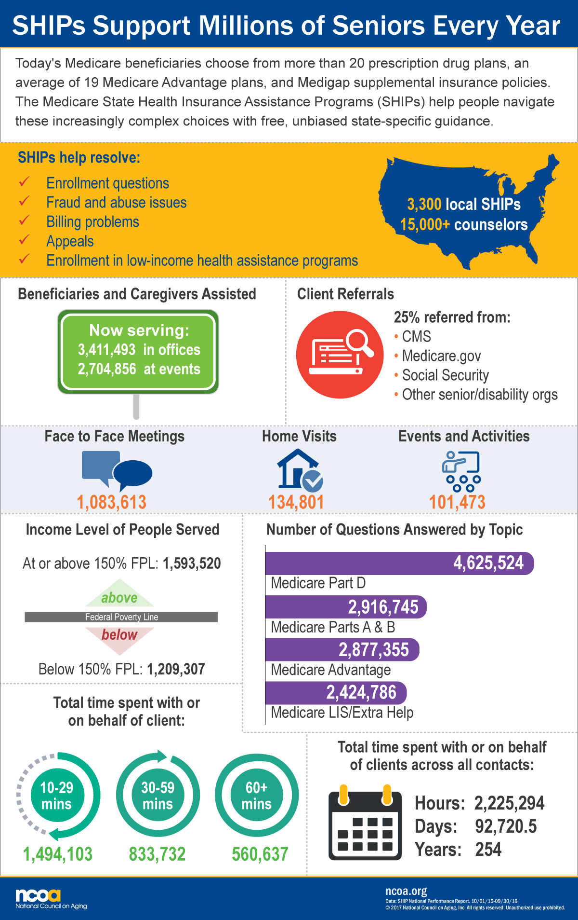

Slide 5
Benefits Enrollment Centers (BECs)
The BECs focus on connecting Medicare beneficiaries with limited incomes to these core benefits:
Medicare Part D Extra Help/Low-Income Subsidy (LIS)
Medicare Savings Programs
Medicaid
Supplemental Nutrition Assistance Program (SNAP – formerly known as Food Stamps)
Low-Income Home Energy Assistance Program
BECs are supported with funding from the Medicare Improvements for Patients and Providers Act (MIPPA), administered through the U.S. Administration for Community Living (ACL). The Center for Benefits Access has supported the creation of BECs since 2009.
Today, there are 69 BECs across the country
Notes:
The BECs focus on connecting Medicare beneficiaries with limited incomes to these core benefits:
Medicare Part D Extra Help/Low-Income Subsidy (LIS)
Medicare Savings Programs
Medicaid
Supplemental Nutrition Assistance Program (SNAP – formerly known as Food Stamps)
Low-Income Home Energy Assistance Program
BECs also help seniors and younger adults with disabilities to apply for other programs, such as Supplemental Security Income, State Pharmaceutical Assistance Programs, local transportation assistance, tax relief, and more.
Funding for BECs
BECs are supported with funding from the Medicare Improvements for Patients and Providers Act (MIPPA), administered through the U.S. Administration for Community Living (ACL). The Center for Benefits Access has supported the creation of BECs since 2009.

Slide 6
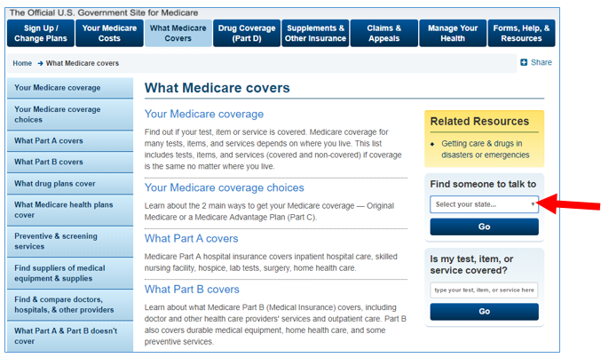
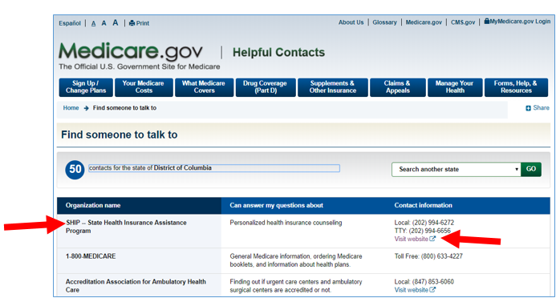
Find Your SHIP
https://www.medicare.gov/what-medicare-covers/index.html
Notes:
Also, SHIP TA Resource Center and ElderCare Locator

Slide 7
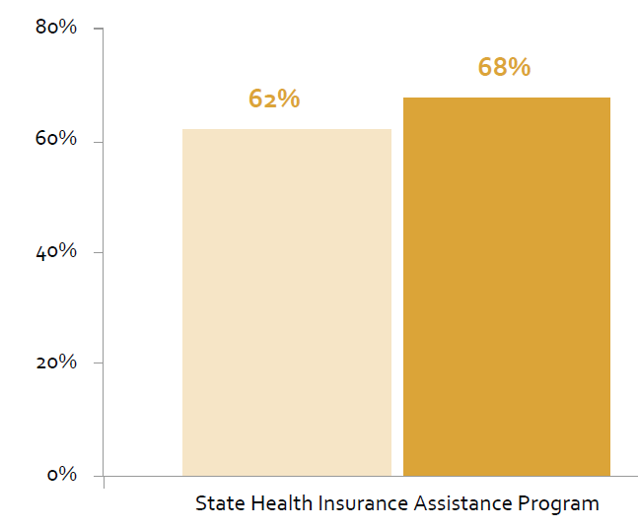
AAAs Designated as SHIP Programs
https://www.n4a.org/Files/2017%20AAA%20Survey%20Report/AAANationalSurvey_web.pdf

Slide 8
SHIP Programming Funding Timeline
SHIP funding remained relatively static for five years not including the FY’13 sequester
FY 2017: Senate proposed eliminating SHIP - President and Senate propose to eliminate - House $52 million recommendation - Compromise: $5 million cut, decreasing SHIP funding to $47 million
FY 2012- FY 2016: $52 million
FY 2016: Senate proposed $22 million cut
FY 2018: President and House propose elimination - Senate: $47 million recommendation - final boost of $2 million to $49 million

Slide 9
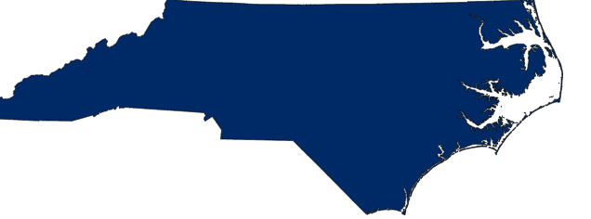
SHIP Savings
MA - $110 Million
Many states have reported that SHIP assistance has resulted in substantial savings to beneficiaries
MI - $56 Million
*dollar figures source: https://www.ncoa.org/blog/straight-talk-seniors-fy18-budget-update-medicare-ship-program/
NC - $53 Million
Notes:
Making informed decisions among an average of 20+ prescription drug plans and 19 Medicare Advantage plans, as well as various Medigap supplemental insurance policies, can save money and improve access to quality care.
In 2015, several states reported achieving significant savings to beneficiaries resulting from SHIP assistance, including $110 million in Massachusetts, $56 million in Michigan, and $53 million in North Carolina.
SHIPs offer increasingly critical services that cannot be supplied by 1-800 MEDICARE, online, or via written materials or other outreach activities. In fact, approximately one-third of all partner referrals to SHIPs originate from Medicare Advantage and Part D prescription drug plans, local and state agencies, the Centers for Medicare and Medicaid Services, the Social Security Administration, and members of Congress and their staff. These partners also include SHIP contact information in their websites, publications, and correspondence to beneficiaries as a trusted source of assistance where individuals can seek help with their Medicare questions.

Slide 10
SHIP Counselor Volunteers
SHIPs oversee a network of more than 3,300 local SHIP offices and over 15,000 counselors.
57% of SHIP counselors are highly trained volunteers who donate almost 2 million hours of assistance annually.*
*https://www.ncoa.org/blog/straight-talk-seniors-fy18-budget-update-medicare-ship-program/

Slide 11
SHIP Training Resources
Because the complexity of health insurance options for Medicare beneficiaries continues to increase, both paid staff and volunteer counselors need ongoing training and access to technical assis­tance.
CMS’ National Medicare Training Program offers monthly webinars, posts training materials on their website for download, and in-person training in limited locations (typically SHIP directors or trainers attend).
ACL also funds a National Technical Assistance Center (SHIP TA Center) , which serves as a central source of information for and about SHIP Programs. The center provides training, technical assistance, and promotional activities in support of the national SHIP program and its 54 individual SHIP projects, including:
Online SHIP counselor training
Online SHIP counselor certification
Subject matter expertise about Medicare and other topics important to SHIPs
Dedicated email channel for answering technical questions about Medicare, Medicaid for dual-eligibles, and other SHIP health insurance questions
Monthly Medicare Minutes - a beneficiary and counselor education tool
Notes:
SHIPs have flexibility in designing the duration of a counselor training program. However, all counselors must complete basic requirements including an initial and annual update training to include a multitude of topics (more details below). SHIPs access training materials generally from these sources:
the Centers for Medicare and Medicaid Services (CMS) National Training Program offers monthly webinars, posts training materials on their website for download, and in-person training in limited locations (typically SHIP directors or trainers attend), and
the SHIP Technical Assistance Center (TA Center) provides online, self-directed training and certification materials.
SHIPs report the number and category of trainings to ACL annually. The most recent report, April 2016-March 2017, details appear below.
At a minimum, a new counselor initial training includes, but not limited to, eligibility rules, application assistance, and troubleshooting with the following:
Original Medicare Parts A & B
Medicare Part C Advantage Plans
Public Benefits Programs for Medicare Beneficiaries
Extra Help for Medicare Part D
Medicare Savings Programs for Original Medicare costs
Medicare Supplemental Policies (Medigap)
Prescription Drug Coverage
Medicare Part D
State Manufacturer Programs
Military Drug Benefits
State Pharmaceutical Assistance Programs
Union/Employer Plan
HIPAA Guidelines and Privacy
Coverage Transitions and Coordination of Benefits
Active Duty/Retired Military
Marketplace
Employer/Retiree Coverage
Workers Comp
Medicaid
Medicare Appeals Processes
Initial Trainings
GY 2016
Number Of Initial Trainings
2,172
Number of Initial Train Attendees
4,050
Number of Initial Trainings Hours
83,421
While seasoned counselors can attend initial training as often as desired, they must attend an annual update training at a minimum. Update trainings typically include, but are not limited to, the following topics:
Medicare Policy updates
Medicare Plan Finder updates
State specific benefit updates
Update Trainings
GY 2016
Number Of Update Trainings
9,285
Number Of Update Train Attendees
12,480
Number Of Update Trainings Total Hours
167,704
In addition, ACL asks SHIPs to identify the counselors’ length of service which appears below:
Years of SHIP Service:
GY 2016 Total
GY 2016 Distribution
Less Than 1 Year
3,023
19.63%
1 To 3 Years
4,037
26.22%
3 To 5 Years
2,590
16.82%
More than 5 years
4,961
32.22%
Not Reported
786
5.10%
Because the complexity of health insurance options for Medicare beneficiaries continues to increase, both paid staff and volunteer counselors need ongoing training and access to technical assis­tance. CMS provides tools to SHIPs, including daily listservs concerning CMS policies and initiatives, monthly phone confer­ences with Baltimore-based CMS staff, and bi-weekly phone con­ferences with CMS Regional Office staff. CMS also convenes an annual SHIP conference to present best practices for SHIP pro­gram delivery and training, and support is available through 1-800-Medicare. In addition to these activities, CMS’ National Medicare Training Program conducts annual regional training sessions for SHIPs and other CMS partners. CMS also funds a National SHIP Resource Center, operated by the American Insti­tute for Research, that provides a variety of technical assistance and training tools, including a password-protected Web site for grantees.7 Also, the Health Assistance Partnership (HAP), a proj­ect of Families USA, offers technical assistance to SHIP state and local staff and volunteers.

Slide 12
SHIP Counselor Training Requirements
At a minimum, a new counselor initial training includes, but not limited to, eligibility rules, application assistance, and troubleshooting with the following:
Original Medicare Parts A & B
Medicare Part C Advantage Plans
Public Benefits Programs for Medicare Beneficiaries
Extra Help for Medicare Part D
Medicare Savings Programs for Original Medicare costs
Medicare Supplemental Policies (Medigap)
Prescription Drug Coverage
Medicare Part D
Military Drug Benefits
State Pharmaceutical Assistance Programs
Union/Employer Plan
HIPAA Guidelines and Privacy
Coverage Transitions and Coordination of Benefits
Active Duty/Retired Military
Marketplace
Employer/Retiree Coverage
Workers Comp
Medicaid
Medicare Appeals Processes
Notes:
Initial Trainings
GY 2016
Number Of Initial Trainings
2,172
Number of Initial Train Attendees
4,050
Number of Initial Trainings Hours
83,421
While seasoned counselors can attend initial training as often as desired, they must attend an annual update training at a minimum. Update trainings typically include, but are not limited to, the following topics:
Medicare Policy updates
Medicare Plan Finder updates
State specific benefit updates
Update Trainings
GY 2016
Number Of Update Trainings
9,285
Number Of Update Train Attendees
12,480
Number Of Update Trainings Total Hours
167,704
In addition, ACL asks SHIPs to identify the counselors’ length of service which appears below:
Years of SHIP Service:
GY 2016 Total
GY 2016 Distribution
Less Than 1 Year
3,023
19.63%
1 To 3 Years
4,037
26.22%
3 To 5 Years
2,590
16.82%
More than 5 years
4,961
32.22%
Not Reported
786
5.10%
Because the complexity of health insurance options for Medicare beneficiaries continues to increase, both paid staff and volunteer counselors need ongoing training and access to technical assis­tance. CMS provides tools to SHIPs, including daily listservs concerning CMS policies and initiatives, monthly phone confer­ences with Baltimore-based CMS staff, and bi-weekly phone con­ferences with CMS Regional Office staff. CMS also convenes an annual SHIP conference to present best practices for SHIP pro­gram delivery and training, and support is available through 1-800-Medicare. In addition to these activities, CMS’ National Medicare Training Program conducts annual regional training sessions for SHIPs and other CMS partners. CMS also funds a National SHIP Resource Center, operated by the American Insti­tute for Research, that provides a variety of technical assistance and training tools, including a password-protected Web site for grantees.7 Also, the Health Assistance Partnership (HAP), a proj­ect of Families USA, offers technical assistance to SHIP state and local staff and volunteers.

Slide 13
The “Business Institute”
The mission of the Aging and Disability Business Institute (Business Institute) is to successfully build and strengthen partnerships between community-based organizations (CBOs) and the health care system so older adults and people with disabilities will have access to services and supports that will enable them to live with dignity and independence in their homes and communities as long as possible.
aginganddisabilitybusinessinstitute.org

Slide 14
Improving Consumer Understanding for Medicare Advantage Enrollees
Notes:
Two new policy actions open the door for partnerships between Medicare Advantage (MA) plans and community-based organizations (CBOs). These changes, which expand the flexibility of MA plans to target supplementary benefits to beneficiaries, are detailed in the Business Institute’s new Policy Spotlight .
The Policy Spotlight summarizes the new opportunities for CBOs made possible by the passage of the Creating High-Quality Results and Outcomes Necessary to Improve Chronic (CHRONIC) Care Act, a part of the Bipartisan Budget Act of 2018, and the release of final policy and payment updates to the MA program through the 2019 Rate Announcement and Call Letter. Both changes allow MA plans to expand the scope of the “primarily health-related supplemental benefit standard,” and update the uniformity requirements for supplemental benefits.
Together, these changes will increase the number of allowable supplemental benefit options and provide MA enrollees with access to benefits and services that may improve their quality of life and health outcomes. They also present a significant opportunity for CBOs) to partner with MA plans.

Slide 15
Questions?
Nora Super
Chief, Programs & Services
202.872.0888
nsuper@@n4a.org
Twitter = @norasuper1

